Slide 1
NOTICE OF FUNDING AVAILABILITY FOR:
ARPA SLFRF SUBRECIPIENT GRANT PROGRAMS
Tuesday, March 5th, 2024, at2 pm Est
Notes:
Slide 1: Dave
Welcome

Slide 2
AGENDA
Purpose
ARPA Overview
Subrecipient vs Beneficiary
NOFA Summary and Structure
How to Apply
Timeline
Questions

Slide 3
PURPOSE
Provide an overview of the city’s ARPA SLFRF Subrecipient Grant Programs
Review eligibility requirements for the programs
Provide an overview of How to Apply
Field any questions

Slide 4
American rescue plan overview
$1.9 Trillion Economic Stimulus Bill
$365 Billion to State-Local Governments
$47.1 Million to the City of Everett

Slide 5
BENEFICIARY V. SUBRECIPIENT
RECIPIENT
Beneficiary
Is an individual or organization receiving the funds as the end user or entity directly benefitting from the financial assistance.
Does not determine eligibility or compliance.
Subrecipient
Subrecipient
Determines who is eligible to receive Federal assistance.
Measures performance based on meeting objectives of the Federal program.
Is responsible for programmatic decision making.
Is responsible for ensuring Federal requirements outlined in the award are followed.
Uses the Federal funds to carry out a program as opposed to providing goods/services.
Beneficiary
Notes:
* On availability of funding

Slide 6
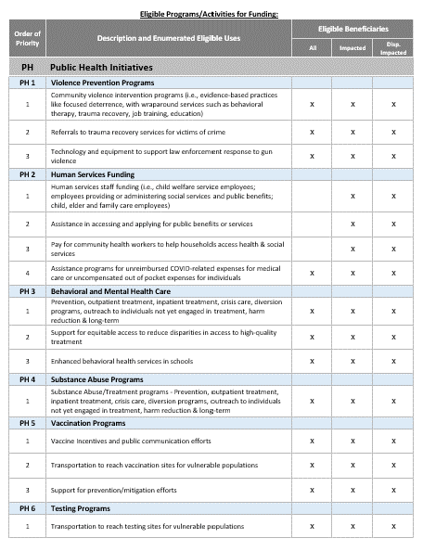
NOFA Summary
Public Health Subrecipient Grant Program
Federal Assistance Listing Number: 21.027
Available to local agencies and organizations including for-profit organizations, non-profit organizations, civic groups, and public health service providers who will carry out an eligible program/activity on behalf of the city.
The city encourages applicants to propose programs and services that will enhance the physical and mental well-being of individuals impacted by the pandemic.

Slide 7
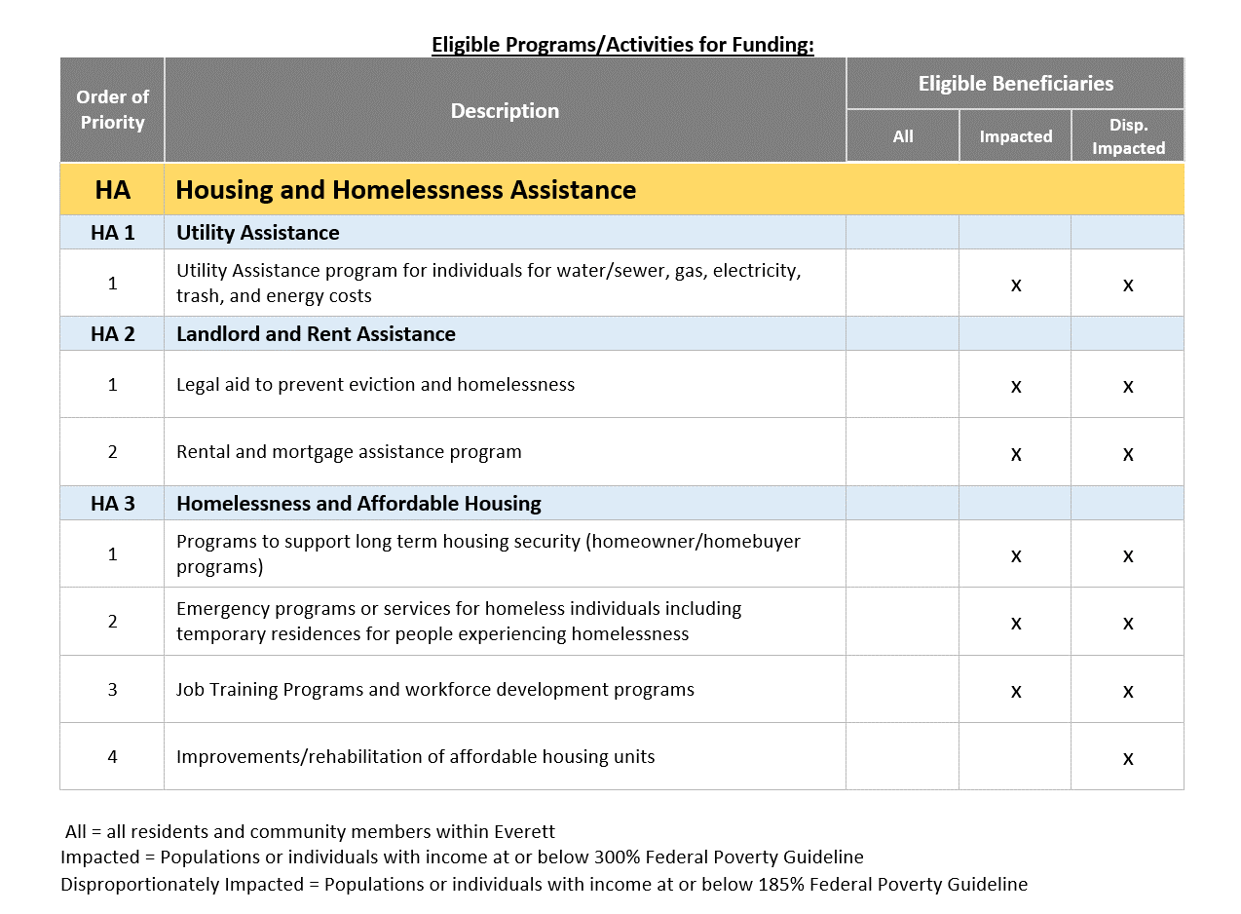
NOFA Summary
Housing Assistance Subrecipient Grant Program
Federal Assistance Listing Number: 21.027
Available to local agencies and organizations including for-profit organizations, non-profit organizations, civic groups, and housing assistance service providers who will carry out an eligible program/activity on behalf of the city.
Must identify the negative impacts the pandemic has had on affordable housing and homelessness within the city, and design or fund a program that helps mitigate those impacts.
Responses to the impacts identified will be required to be related and reasonably proportional to the harm sustained and reasonably designed to benefit those impacted.

Slide 8
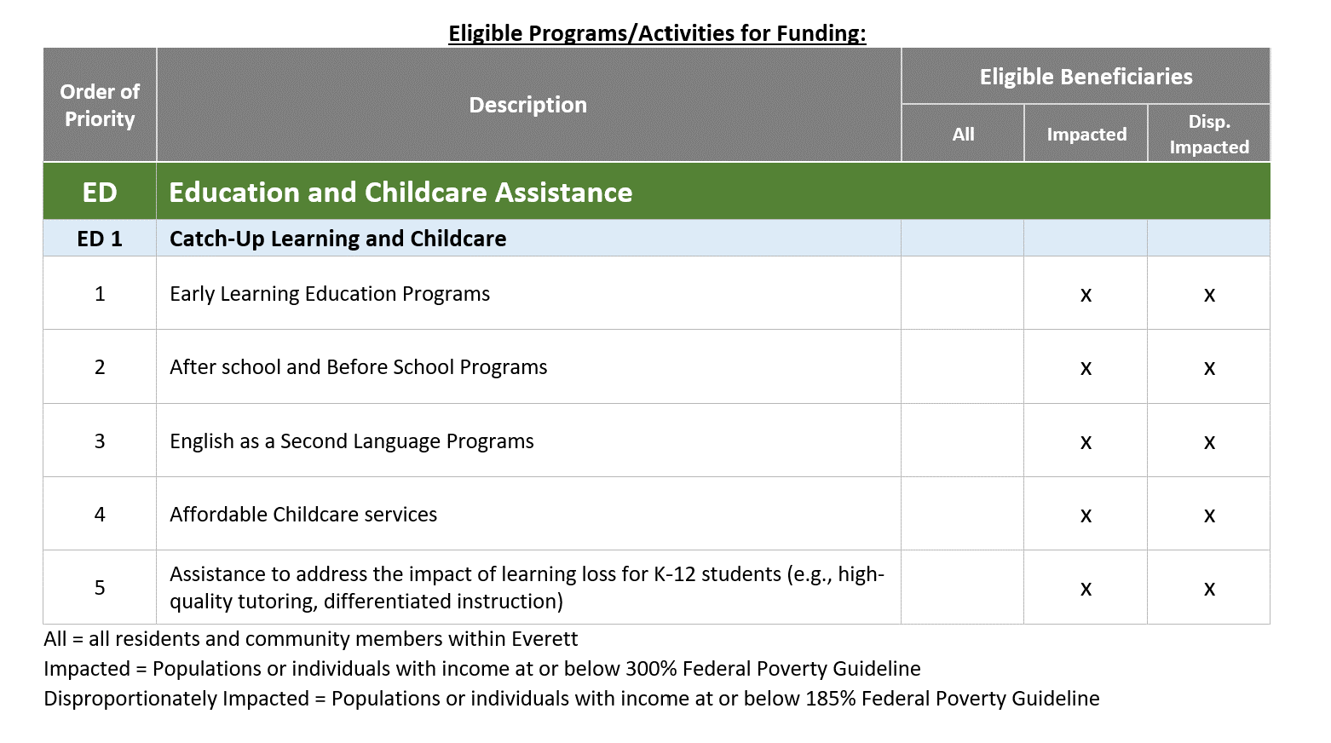
NOFA Summary
Education and Childcare Subrecipient Grant Program
Federal Assistance Listing Number: 21.027
Available to local agencies and organizations including for-profit organizations, non-profit organizations, educational and childcare service providers who will carry out an eligible program/activity on behalf of the city.
Must identify the negative impacts the pandemic has had on education and childcare within the city, and design or fund a program that helps mitigate those impacts.
Responses to the impacts identified will be required to be related and reasonably proportional to the harm sustained and reasonably designed to benefit those impacted.

Slide 9
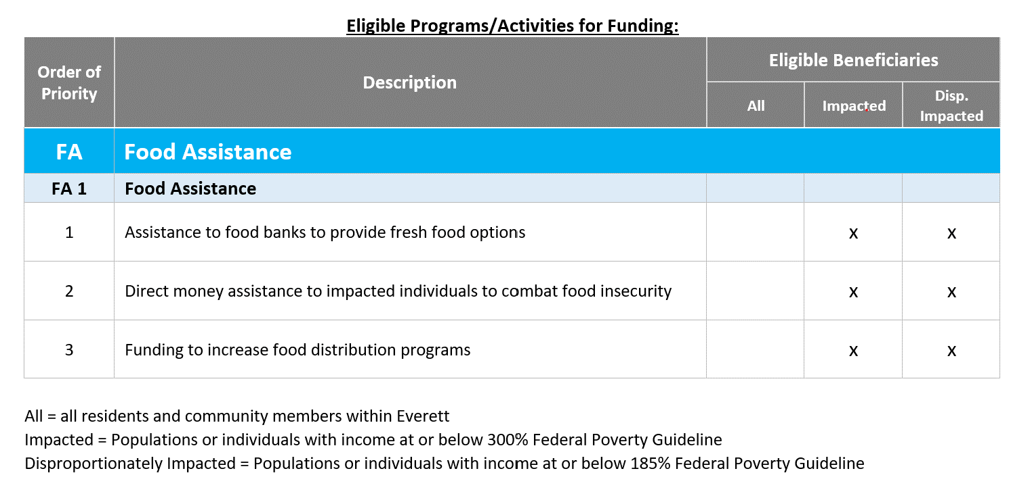
NOFA Summary
Food Assistance Subrecipient Grant Program
Federal Assistance Listing Number: 21.027
Available to local agencies and organizations including for-profit organizations, non-profit organizations, civic groups, and food assistance service providers who will carry out an eligible program/activity on behalf of the city.
The city encourages applicants to propose programs and services that will assist in the elimination of food instability experienced by residents caused by the health emergency.

Slide 10
Subrecipients
General Eligibility Requirements
Must be physically located in the City of Everett OR provide evidence that the organization directly serves the residents/community of Everett.
Must provide proof of current license, certification, or registration confirming it is authorized to provide service in the city and/or county.
Must not discriminate based on age, sex, religion, national origin, disability, economic status, or sexual orientation.
Must disclose any potential conflicts of interest for the city to evaluate.
No owners, including all managing members and/or officers of the organization, have been convicted of financial crimes within the past three (3) years
Must provide proof of insurance to the satisfaction of the City prior to the receipt of any funding.
Must be in good standing with the city and current on local taxes and city utility bills.
Must be in good standing and in compliance with all applicable Federal, State and Local laws.
Must have a Unique Entity ID (UEI) and maintain an active SAM.gov registration status throughout the period of performance.
Must not be debarred or suspended from receiving or managing federal funds.
Must not have received alternate Federal, State or Local grant funding that fully covers the same costs, programs, and/or impacts identified in its grant application to the city. Please note, unmet program funding needs, regardless of alternate funding received, are still eligible for funding.

Slide 11
Subrecipients
Eligibility Documentation Requirements
Completed Application
Completed Budget Worksheet for the Proposed Program
Completed Duplication of Benefit Worksheet
Completed Conflict of Interest Form
Current Signed IRS W-9 Tax Form
Balance Sheet for Two (2) Most Recent Fiscal Years
Completed capital expenditure budget worksheet (only if applicable)
UEI Number and SAM.gov Registration Certificate or Proof of Registration
The city reserves the right to request additional information from the applicant as needed
DOMESTIC VIOLENCE PREVENTION SERVICE PROVIDERS
FOOD INSECURITY SERVICE PROVIDERS
SUBSTANCE ABUSE
& MENTAL HEALTH SERVICE PROVIDERS
SPECIAL NEEDS/ADA SERVICE PROVIDERS
CHILDCARE & AFTER SCHOOL PRORGAM SERVICE PROVIDERS

Slide 12
Scoring criteria
The city will establish a review committee to review grant applications for completeness, eligibility, and final award. Review panel members may consider the following factors in their evaluation:
Applicant is a qualifying and eligible entity (10 pts)
Fiscal and administrative capacity of the subrecipient to administer the funding in compliance with Federal requirements.
Completeness of grant application narrative and required documents
Risk assessment and project/program eligibility
Impact (15 pts)
Alignment of the request with the city’s mission and vision
Impact the funding will have on underserved groups and local community
Applicant’s quality of performance measures submitted for compliance monitoring
Readiness (5 pts)
Applicant’s readiness to fund the program and capacity for implementation
Budget (15 pts)
Grant budget is provided, reasonable, and aligns with eligible uses as defined by Treasury.
Duplication of Benefit Analysis
Program viability after ARPA SLFRF funding is fully exhausted
Applicant’s ability and commitment to fully expend fund by September 30, 2026.
Other factors as deemed appropriate by the panel members (5 pts)

Slide 13
How to apply
The grant application process is streamlined through the online Zoom Grants management portal.
URL: Everett ARPA - Everett, MA - Official Website (cityofeverett.com)
For any questions regarding the program or application assistance, you can contact ARPA_Everett@ci.everett.ma.us
How to create a login and access the portal Click “Apply Today” on the grant webpage From here you’ll be redirected to the grant portal. Once at the grant portal, create a New ZoomGrants Account. Click “Apply”. *If you already have an account, login as an existing ZoomGrants User | 2. How to begin and submit an application: Follow the steps on the ZoomGrants portal, see step 1. Complete the application Attach the completed forms to your document when prompted in the portal. Submit application.

Slide 14
How to apply
Subrecipient Budget Worksheet
Applicants applying for SUBRECIPIENT GRANT FUNDING are required to complete and submit this worksheet with their application. Applicants are to fill out the budget according to the specifics of their proposed program.

Slide 15
How to apply
Duplication of Benefit Worksheet
If an applicant has received alternate grant funding from other sources that are intended to be used for this same purpose, the applicant will need to disclose those sources and amounts so a duplication of benefit analysis can be conducted.

Slide 16
timeline
February 23rd, 2024, Release of Application
February 23rd – June 7th, 2024, Technical Assistance Upon Request
June 7th, 2024, Deadline for Application Submissions
June 7th – July 12th, 2024, Application review period
July 15th, 2024, Award Determinations
July 15th – July 31st, 2024, Issue MOU’s and Grant Agreements
Program | Total Allocated to Program | Max Award Per Eligible Applicant
Public Health Programs | $4,300,000.00 | $500,000.00
Housing Assistance Programs | $3,700,000.00 | $500,000.00
Education and Childcare Assistance Programs | $1,400,000.00 | $500,000.00
Food Assistance Programs | $1,100,000.00 | $500,000.00

Slide 17
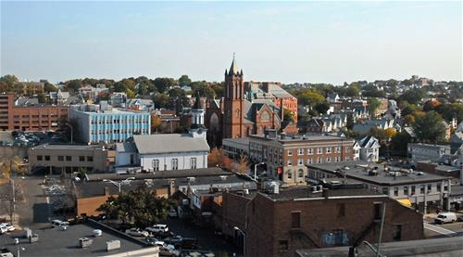
QUESTIONS?
Notes:
Slide 1: Dave
Welcome

